Slide 1
Chameleon

Slide 2
Overview
(review)

Slide 3
Digital Gearheads
  Ben Carhart, David Czechowski, Mark Erikson
Mission Statement
  "To design and develop Chameleon, an adaptive Integrated Development Environment designed for instructional purposes. The goal of the Chameleon I.D.E. is to provide an environment with which an introductory computer science students can be comfortable in, and also have the ability to adapt with the student as the skill and functionality needs of the student change.”
  Basic concept: an IDE whose features and complexity can be set by the professor
  Targeted at CS 1210/1220 students (ie, students with experience ranging from none to about one year), their prof, and possibly upper-level CS students.

Slide 4
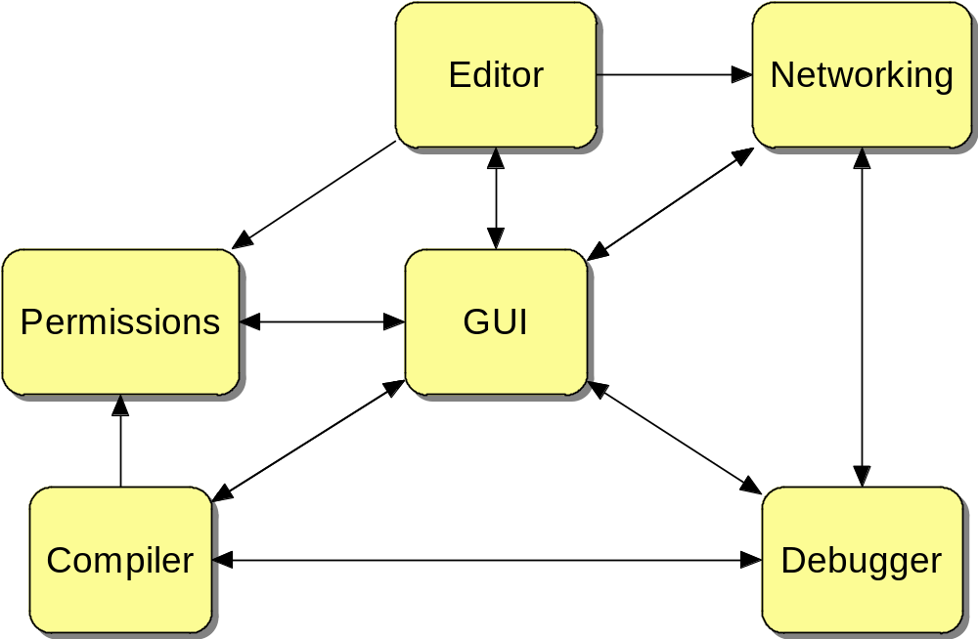
Notes:
Bunch of (semi) independent tools, bunched together into what we know as an IDE

Slide 5
5½ Major Activities / Tasks

Slide 6
1.) Networking
  File transfer Redesign
  Synch vs Asynch
  Status: Done/Ongoing
2.) Bug Fixing
  Several issues discovered during testing
  All reported issues have been fixed at this point
  Many minor tweaks made as well
  Code review
  Status: when ISN’T it ongoing?

Slide 7
3.) Terminal
  SSH and vt100
  Research shows we should be able to reuse pre-existing code
  Several issues to deal with, but doable
  Current major issue
  Status: Ongoing
4.) Remote File Dialog
  Implemented a (near) duplicate of the Windows dialog from scratch
  Took far longer than expected (lot of functionality to write)
  Works quite well, looks reasonably like the original
  Status: done

Slide 8
5.) Debugger
  Abstraction layer defined and in progress
  GDB research basically done
  Working with Debugginator team on implementation issues
  Status: ongoing
5 ½.) Beta
  Major in accomplishment – Minor in activity
  sguB
  Shows it works
  Demo’ing to our customer
  Working with CS1210 students on feedback
  Status: ongoing

Slide 9
Status

Slide 10
GUI – 60-ish% complete
  Embedded Terminal
  Multiple files open in tabs
  Professor options program
Editor - 60% complete
  Open & save local and remote files
  Syntax highlighting
Networking - 75% complete
  Basic Networking Complete
  Further tweaks possible

Slide 11
Compiler - 15% complete
  Dependency on Networking
  Relatively little to do (Networking already has I/O)
Permissions - 95% complete
  Client-side relatively integrated
  Correctly maintains authorize / status variables
Debugger - 20% complete
  Initial research / program acquisition complete
  I/O Research

Slide 12
Gantt chart

Slide 13
Status
Risks

Slide 14
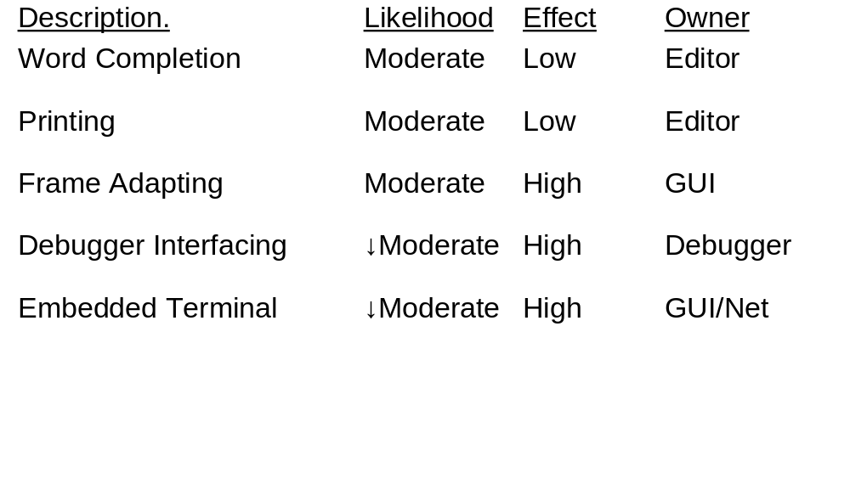

Slide 15
Demo Time!

Slide 16
Summary Comments...
Overall Health of the project
Any project-wide issues?
What have you learned (teamwork, management, planning, coordinating, etc.)?

Slide 17

Questions

